Slide 1
Income Analysis
Hetansh Patel

Slide 2
ABOUT Data
The dataset contains 16 columns.
Target filed: Income
The income is divide into two classes: <=50K and >50K
Number of attributes: 14 - These are the demographics and other features to describe a person
We can explore the possibility in predicting income level based on the individual’s personal information.

Slide 3
Data collection
Data Website: https://www.kaggle.com/datasets/wenruliu/adult-income-dataset/data

Slide 4
Pre-Processing

Slide 5
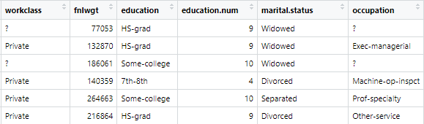
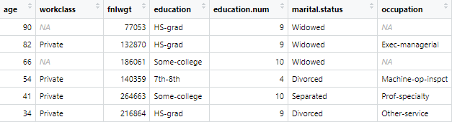

Pre-Processing
Before
After

Slide 6
Handling NA values
There were NA values in following columns:
Workclass
Occupation
Native Country
All of them are Character type. So we can’t just apply random values inside them. Its better to delete the entire rows rather than giving misleading information.

Slide 7
Data Exploration

Slide 8
Reviewing each feature
Age - Age of a Person
Workclasss –Type of workclass (i.e. Private, Government, Self-Employed, Others)
Fnlwgt – This stands for Final weight.(Represents the number of people that an observation in the dataset represents in a sample)
Education – Education level of a person
Education.num – Numerical representation of education level(Number of years of education)
Marital.status –Marital status of a person(i.e. Married,divorced, etc.)
Occupation – Type of occupation
Relationship – Relationship Status(i.e. Wife, Husband, Not in family, etc.)
Race – Ethnicity of Person
Gender – Gender of a person
Capital.gain – Financial gain of individual from investments or capital assets.
Capital.loss – Financial loss of individual from investments or capital assets.
Hours.per.week – Number of hours a person works per week.
Native.country – Native country of an individual.
Income(Target Variable) - Income of a person(less than or more than 50K)

Slide 9
Types
Age - Integer
Workclasss – Character
Fnlwgt –Integer
Education – Character
Education.num –Integer
Marital.status –Character
Occupation – Character
Relationship – Character
Race – Character
Gender – Character
Capital.gain – Integer
Capital.loss – Integer
Hours.per.week – Integer
Native.country – Character
Income(Target Variable) - Character

Slide 10
Problem Statement

Slide 11
Problem in Data Set
The main problem in this data set is most of the features are in character types.
That’s makes analyzing data difficult because many statistical and machine learning methods are designed to work with numerical data.
Categorical columns with large number of categories can lead to high-dimensional feature space. It might lead to overfitting in predictive modeling.
Interpreting and visualizing the results of analysis can be more challenging when dealing with categorical data.
Handling missing values in categorical data can be more complicated.
Selecting relevant features becomes more challenging with a large number of categorical columns.

Slide 12
Data Transformation

Slide 13
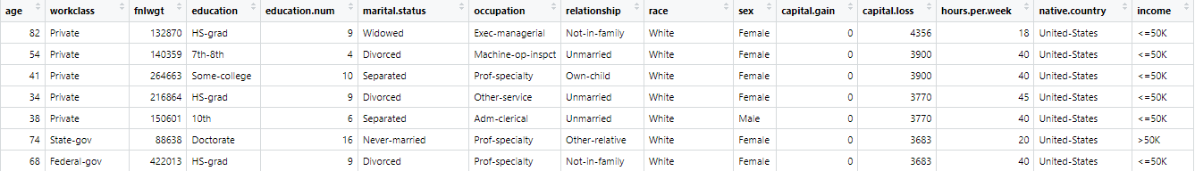
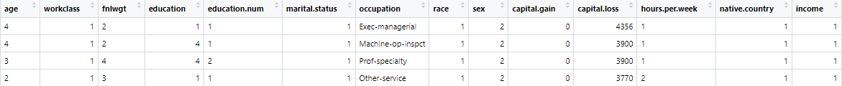
Giving categories
Transforming character data into categorical variables. This transformation will make our data set more compatible with more statistical techniques. Categorizing each character column to numerical codes, simplifying data while retaining its essential information. This process enhances our dataset’s suitability for statistical analysis, setting the stage for deeper exploration and insights.

Slide 14
Occupation Feature
Occupation column contains extensive list of diverse categories, making it impractical to transform into traditional categories variables. To overcome this problem I decided to generate new columns, each representing a specific occupation category. By implying this technique it is easier to transform complex occupation data into binary values. For each occupation, a new column is assigned with binary values such as True and False.

Slide 15
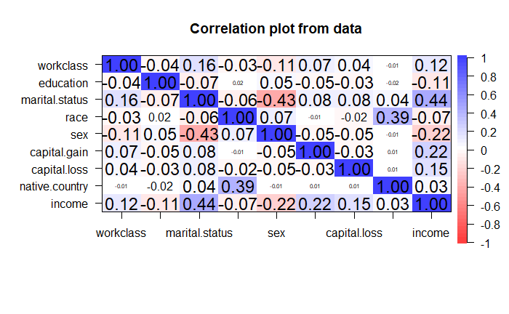
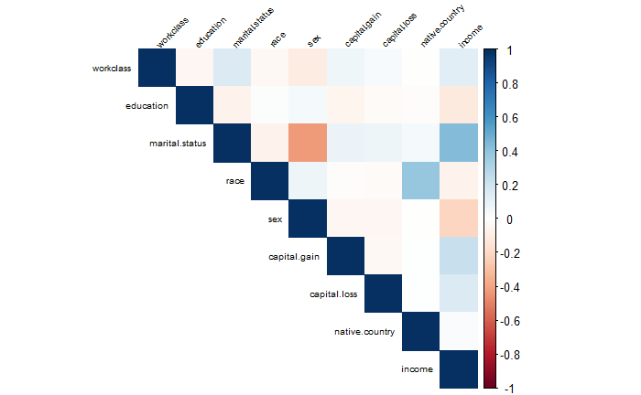
Correlating data
Objective of this was to discern which features within the dataset held the most relevance and which ones were less informative. This process allows us to gain insights into the interrelationships between different variables. It is important to eliminate less influential features to reduce dimensionality and enhancing the efficiency of our analysis. This approach to data reduction ensures to focus more on critical aspects of data.

Slide 16
Data Visualizing

Slide 17
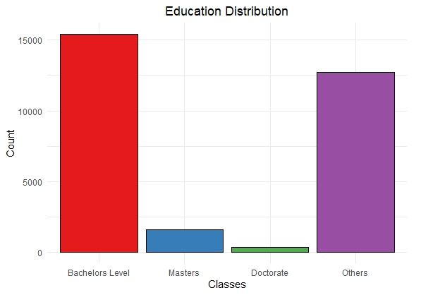
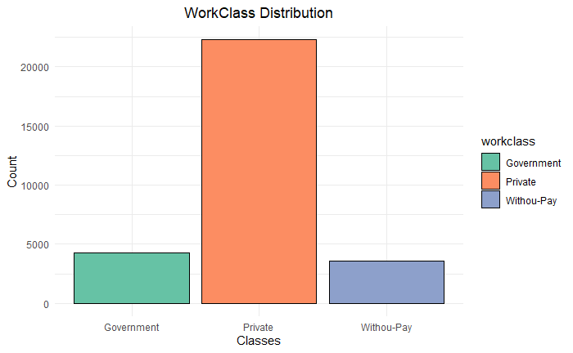
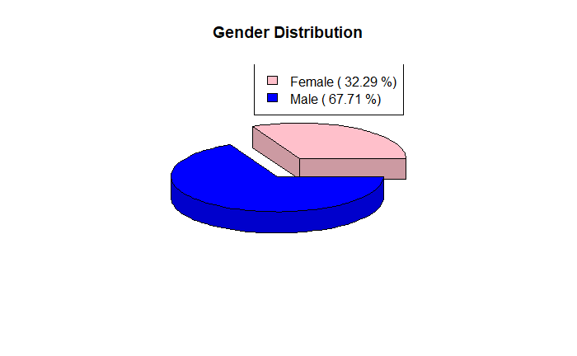
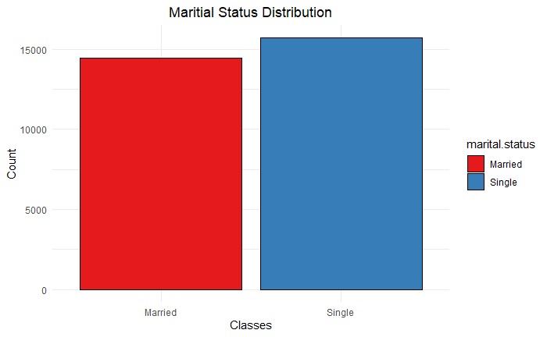
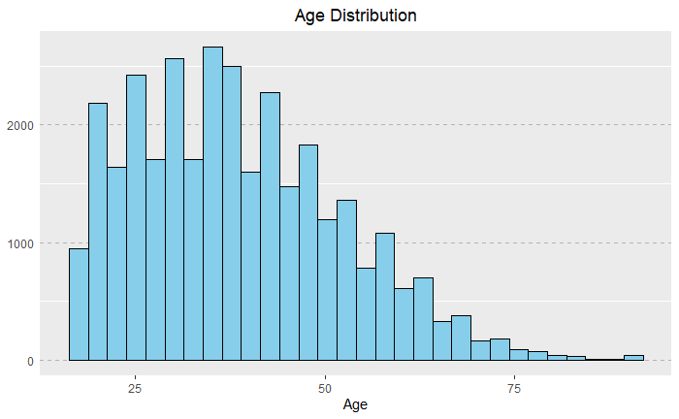
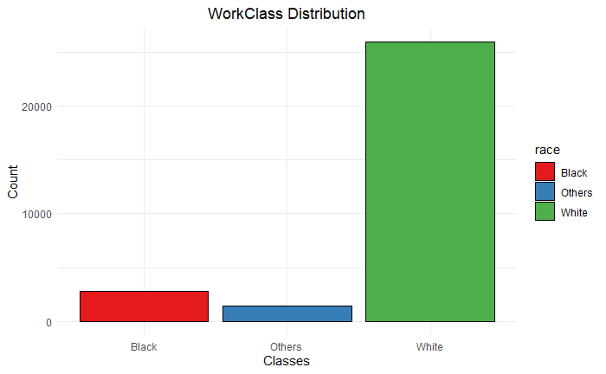
Overview of data

Slide 18
Problem Statement
Binary Classification
Targeting Services
The dataset contains demographic and socioeconomic attributes, and the main problem is to build a predictive model that classifies individuals into two income groups based on a threshold income level
The primary goal is to assist in resource allocation and financial planning by accurately identifying individuals at risk of low income, enabling targeted services and interventions.

Slide 19
Methodology

Slide 20
Algorithms
Decision Trees: They create a tree like structure where each internal node represents a decision, and each leaf node represents the outcome.
Random Forest: An ensemble learning method that combines multiple decision tree to improve predictive accuracy. It reduces overfitting by introducing randomness in the tree-building process.
Support Vector Machines: It can handle high-dimensional data and is effective for both linear and non-linear classification problems. It aims to maximize the margin between classes, making it robust and accurate.
Naïve Bayes: This is a probabilistic algorithm that relies on Bayes’ Theorem for classification. It assumes that features are independent, which simplifies the calculations.
Logistics Regression: This algorithm models relationship between the dependent binary variable and one or more independent variables. It provides probability score for each observation, which can be used to make predictions.

Slide 21
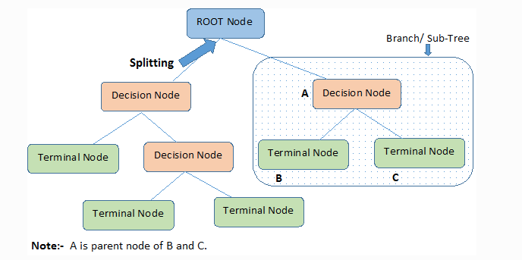
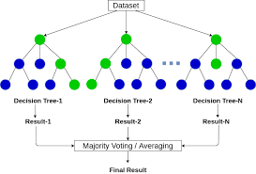
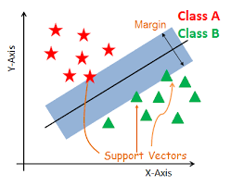
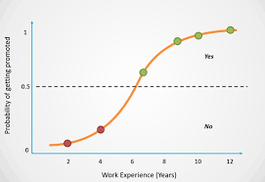
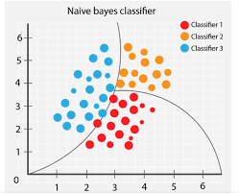
Visual Representation of algorithms
Decision Trees
Random Forest
Support Vector Machines
Logistic Regression
Naïve Bayes Classifier

Slide 22
Results

Slide 23
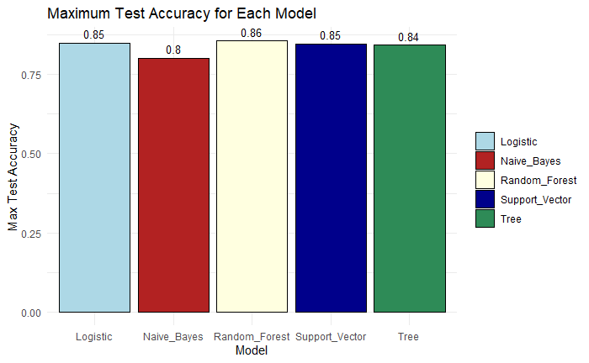
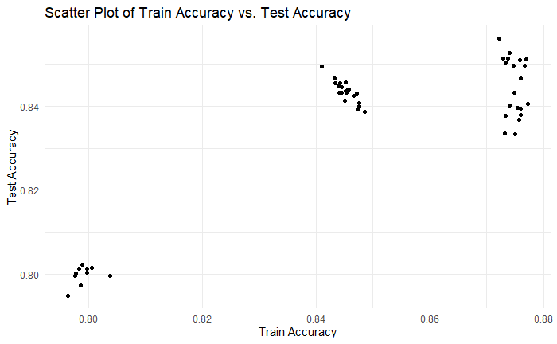
Test accuracy for each model
Bar Chart
Scatter Plot

Slide 24
Sample result Dataset
Dataset_Number | Model | Train_Accuracy | Test_Accuracy
1 | Decision_Tree | 0.874 | 0.840
2 | Decision_Tree | 0.875 | 0.836
1 | Random_Forest | 0.873 | 0.851
2 | Random_Forest | 0.876 | 0.849
1 | Support_Vector | 0.844 | 0.843
2 | Support_Vector | 0.843 | 0.846
1 | Naïve_Bayes | 0.798 | 0.802
2 | Naïve_Bayes | 0.797 | 0.799
1 | Logistic_Regression | 0.844 | 0.843
2 | Logistic_Regression | 0.847 | 0.840

Slide 25
Problem
Memory Usage
Large datasets can demand significant memory resources.
Some algorithms may struggle or fail to execute on machines with insufficient RAM.
Computational Time
Processing large amounts of data can be time-consuming.
Some algorithms might be computationally expensive and impractical for large datasets.
Storage and Retrieval
Storing large datasets can be challenging, especially if frequent backups are needed.
Accessing specific subsets of data from large datasets might become slow.
Real–Time Processing
For applications requiring real–time predictions, handling large datasets in real–time can be a significant challenge

Slide 26
Solution
I employed trail and error method for feature selection. Recognizing the impact of certain features on the efficiency of the dataset, removed variables to gauge their influence on the overall performance. Through this iterative process, I successfully identified and eliminated features that contributed minimal values or introduced noise to dataset.
This approach made my models more efficient considering storage and time. This drop storage from 64 MB to 24 MB reducing it to around 62.5%.

Slide 27
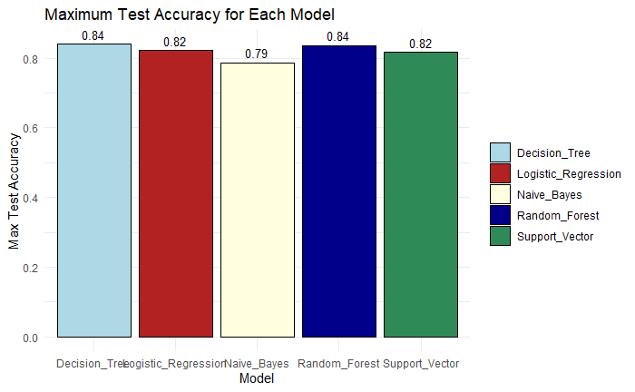
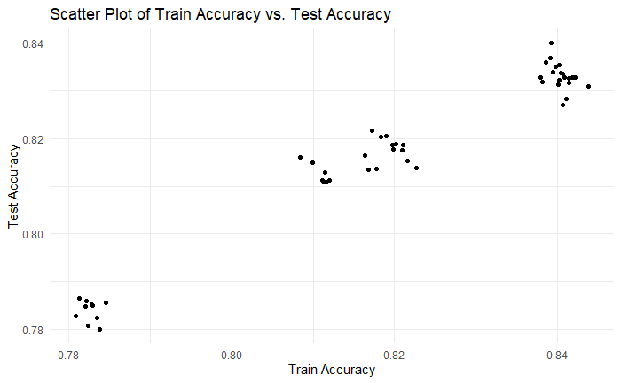
Test accuracy for updated data
Bar Chart
Scatter Plot

Slide 28
Sample result Dataset
Dataset_Number | Model | Train_Accuracy | Test_Accuracy
1 | Decision_Tree | 0.839 | 0.836
2 | Decision_Tree | 0.839 | 0.835
1 | Random_Forest | 0.841 | 0.832
2 | Random_Forest | 0.841 | 0.828
1 | Support_Vector | 0.811 | 0.810
2 | Support_Vector | 0.811 | 0.812
1 | Naïve_Bayes | 0.780 | 0.782
2 | Naïve_Bayes | 0.782 | 0.785
1 | Logistic_Regression | 0.817 | 0.821
2 | Logistic_Regression | 0.819 | 0.817

Slide 29
Change in Prediction
As we can see predictions before are higher than our more efficient dataset.
But if we see percentage difference its very close, It just dropped by 1.5%.

Slide 30
Importance of Features
From this trail and error method we know most important features of datasets. They are:
Age
Work Class
Education
Marital status
Gender
Capital Gain
Capital Loss
Hours per Week

Slide 31
Use Cases
Credit scoring
Financial institutions can use the analysis to assess an individual's creditworthiness. By considering income, employment, and other factors, they can make informed decisions on lending and setting interest rates.
Marketing
Companies can target their marketing efforts more effectively by understanding the income and demographic profiles of their customers. This can lead to personalized advertising and product recommendations.
Government policy
Governments and policymakers can use the analysis to design and evaluate social programs, tax policies, and measures aimed at reducing income inequality or improving economic conditions for specific demographic groups.
Education planning
Educational institutions can use the information to create targeted scholarship programs, improve educational outcomes, and provide resources to students from underprivileged backgrounds.

Slide 32
THANK YOU
Any Questions?

